Slide 1

Wide Angle Scattering and Pair Distribution Functions
Dr Katharina Edkins
The University of Manchester
@k_edkins

Slide 2
Overview
Diffraction
What are the effects of increasing disorder?
Small vs wide angle scattering
Pair distribution function
Examples

Slide 3
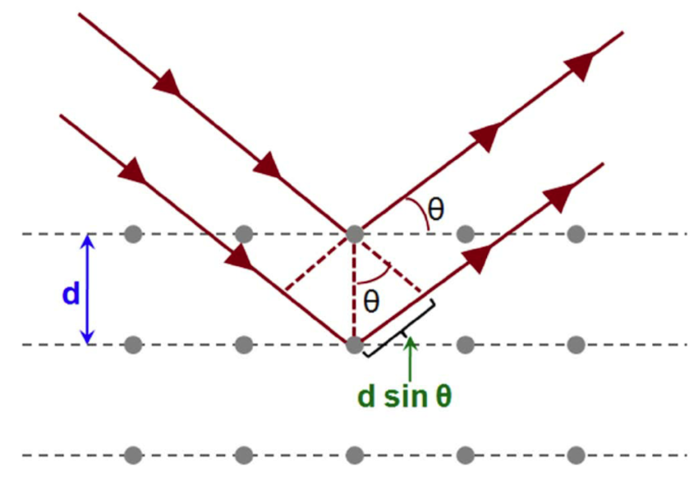
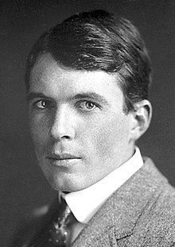
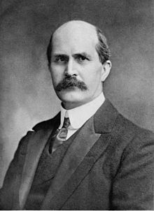
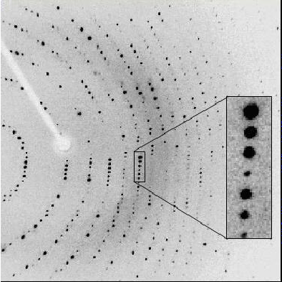
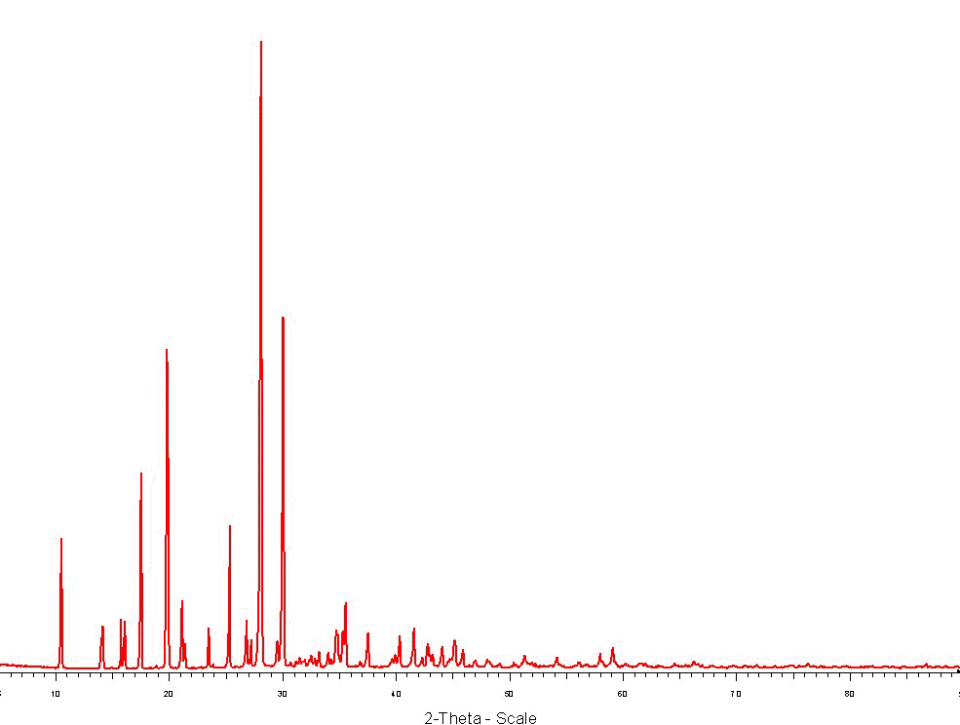
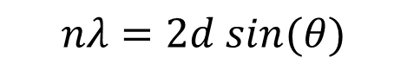
Diffraction
$$nλ=2d sin(θ)$$

Slide 4
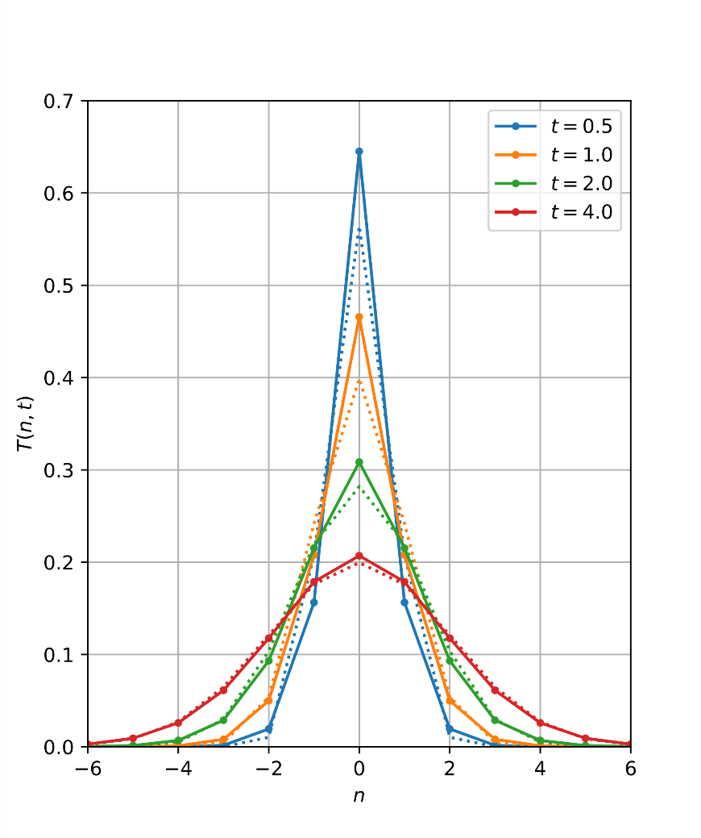
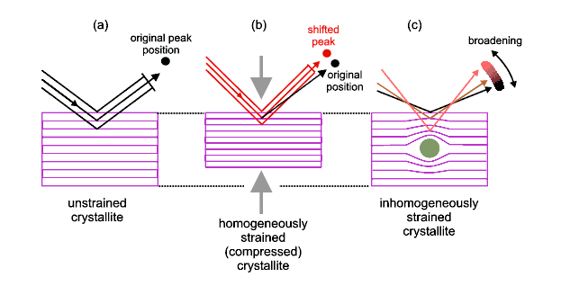
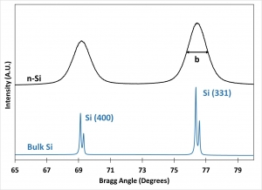
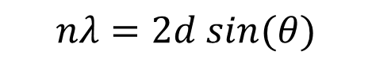
Diffraction
$$nλ=2d sin(θ)$$
Birkbeck College

Slide 5
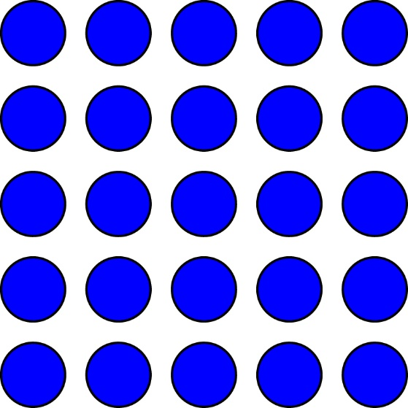
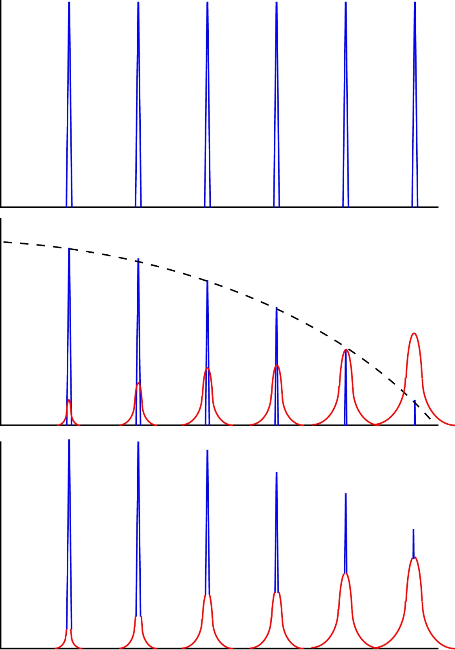
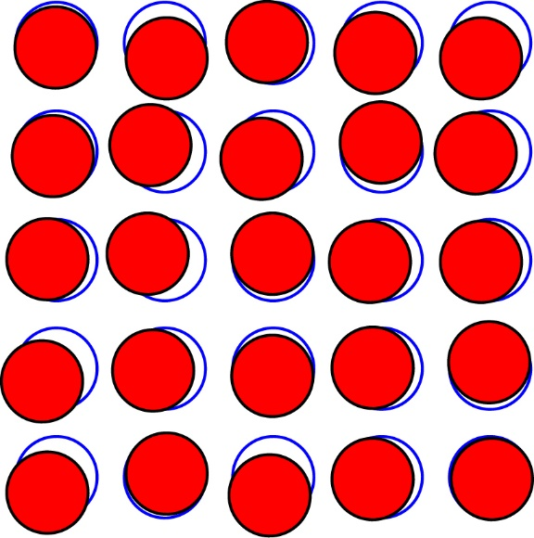
The effect of temperature
T = 0K
T > 0K

Slide 6
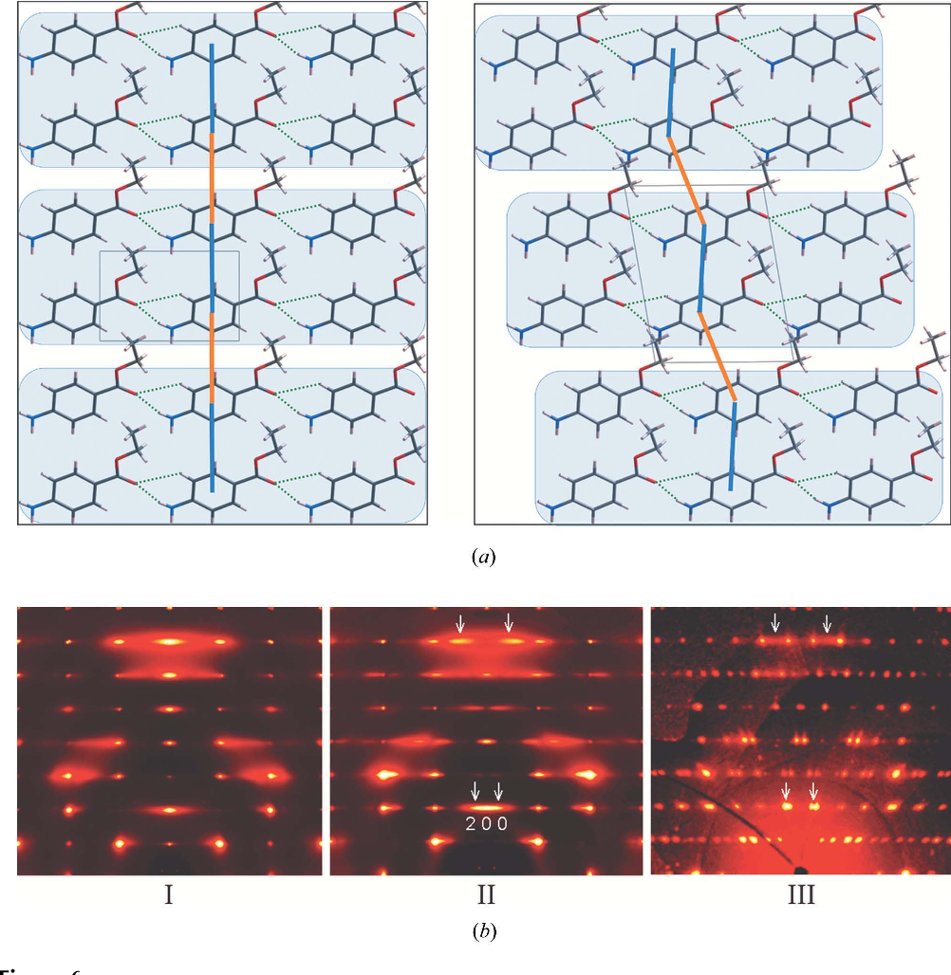
The effect of dislocation
Single-crystal diffuse scattering studies on polymorphs of molecular crystals. I. The room-temperature polymorphs of the drug benzocaine.
E.J. Chan, T.R. Welberry, D.J. Goossens, A.P. Heerdegen, A. Beasley, P.J. Chupas
DOI:10.1107/S0108768109015857

Slide 7
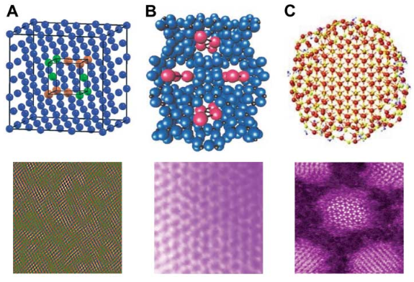
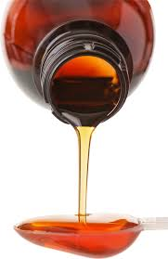
Nanoscale structure
Science, 2007, 316, 561

Slide 8
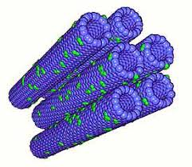
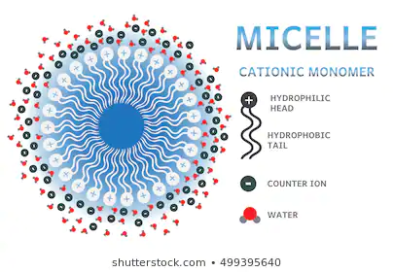
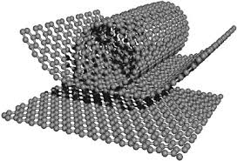
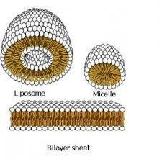
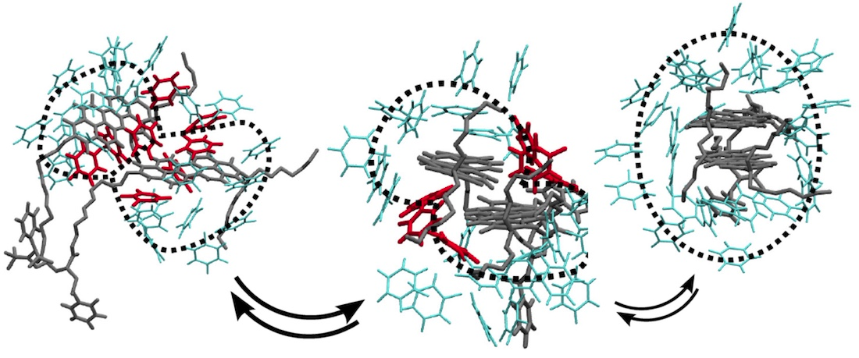
Wide vs small angle scattering
Wide Angle Scattering < 10⁻⁹ m
Small Angle Scattering > 10⁻⁹ m

Slide 9
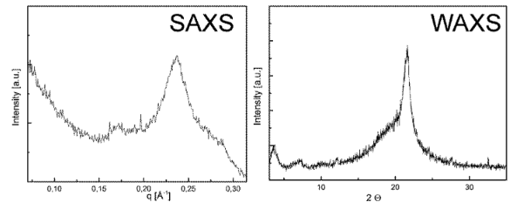
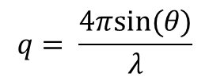
Wide vs small angle scattering
$$q= \frac{4πsin⁡(θ)}{λ}$$
Amorphous poly(phosphoamidate), data acquired with Cu Kα radiation (λ = 1.54 Å)
2.7 nm
30˚ 2θ: q = 2.1 Å⁻¹
4˚ 2θ
40˚ 2θ: d = 2.25 Å
Polym. Chem.,2016, 7, 5004–5010

Slide 10
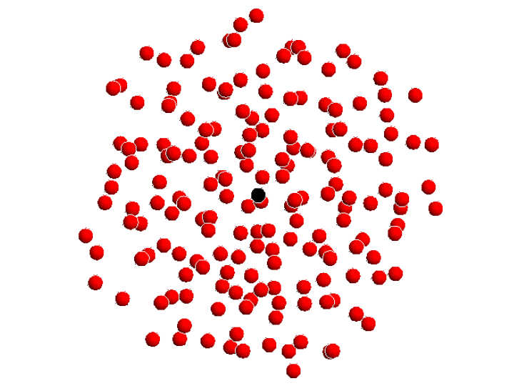
Pair distribution function
© Alan Soper

Slide 11
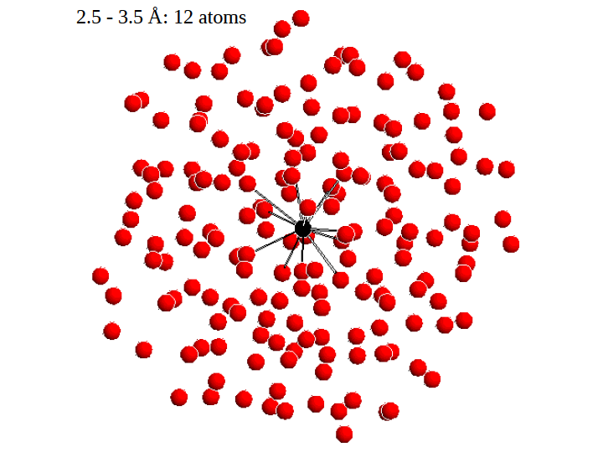
Pair distribution function
© Alan Soper

Slide 12
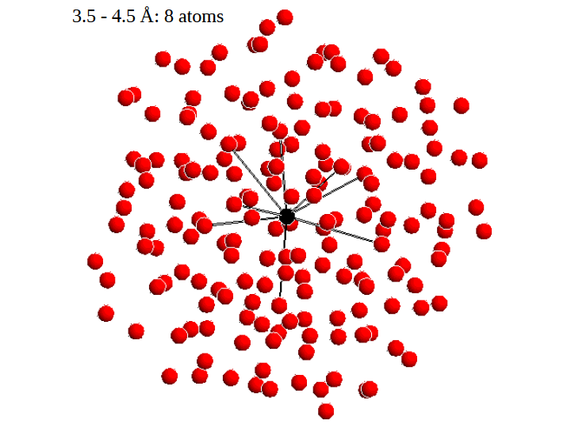
Pair distribution function
© Alan Soper

Slide 13
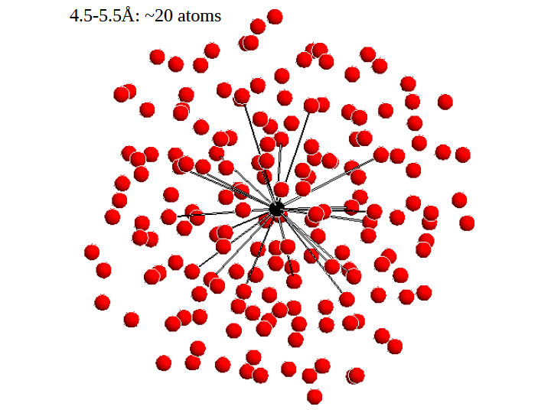
Pair distribution function
© Alan Soper

Slide 14

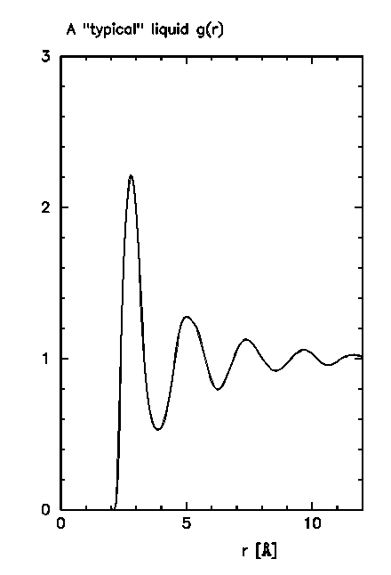

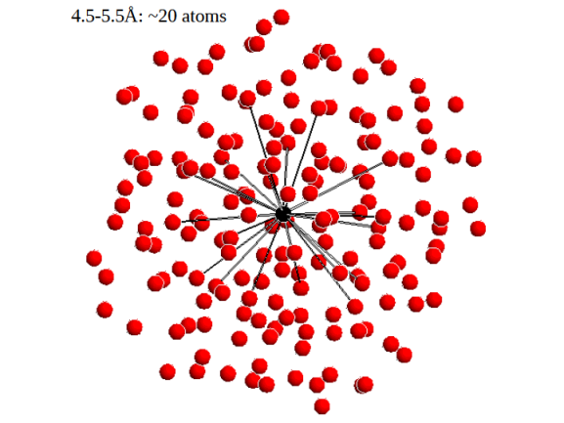
Pair distribution function

Slide 15
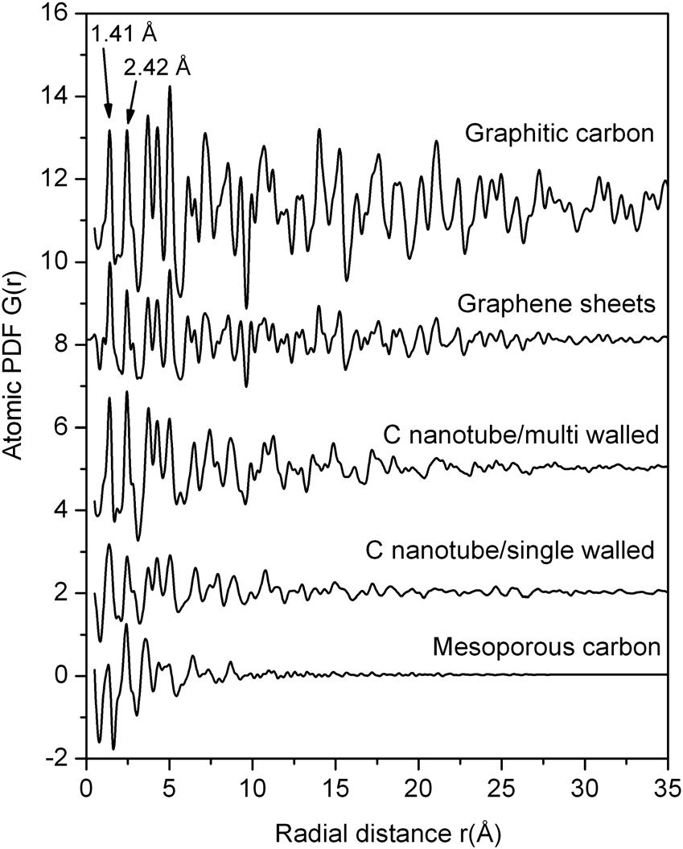
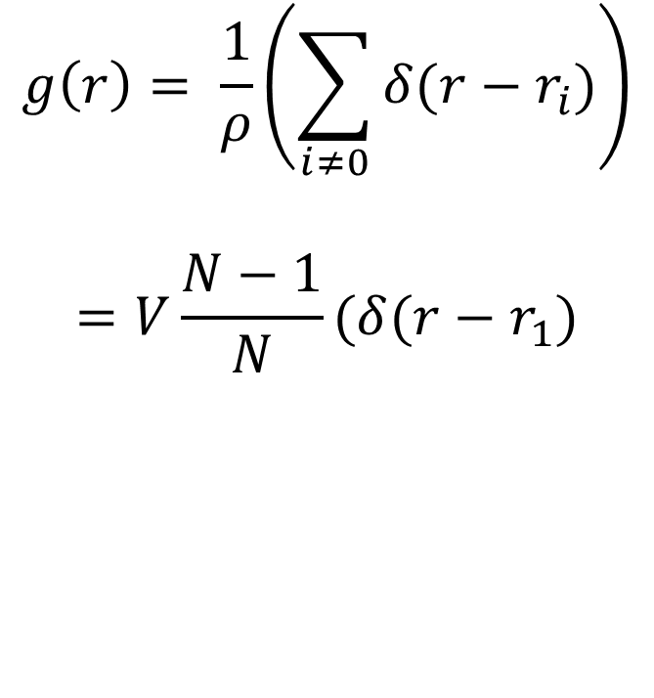
Pair distribution function
$$g\left(r\right)= \frac{1}{ρ}\left(\sum_{i≠0}{δ(r−r_{i})}\right)$$
$$=V\frac{N−1}{N}(δ(r−r_{1})$$

Slide 16
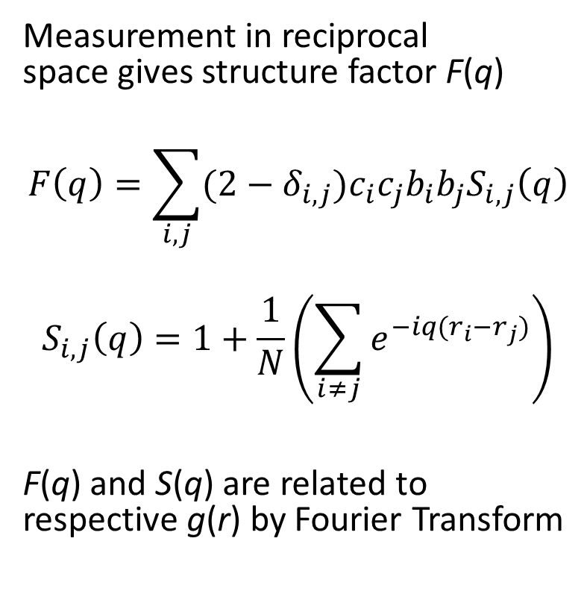
Pair distribution function
Measurement in reciprocal space gives structure factor F(q)
$$F\left(q\right)=\sum_{i,j}{(2−δ_{i,j})c_{i}c_{j}b_{i}b_{j}S_{i,j}\left(q\right)}$$
$$S_{i,j}\left(q\right)=1+\frac{1}{N}\left(\sum_{i≠j}{e^{−iq(r_{i}−r_{j})}}\right)$$
F(q) and S(q) are related to respective g(r) by Fourier Transform
Partial structure factor

Slide 17
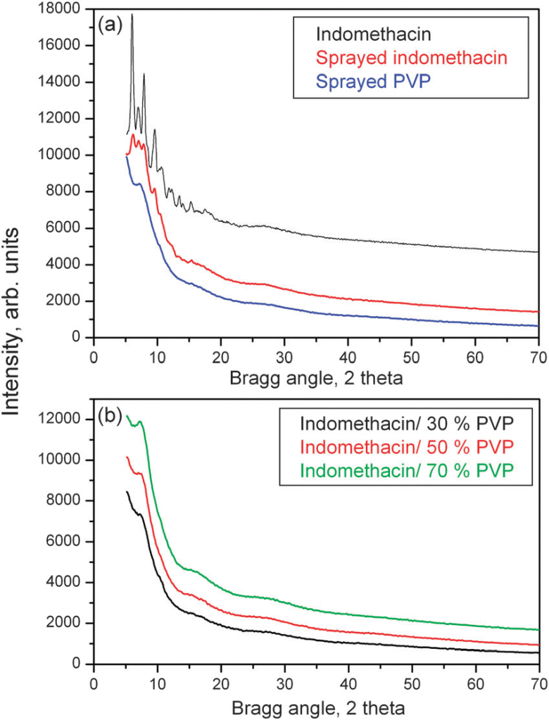
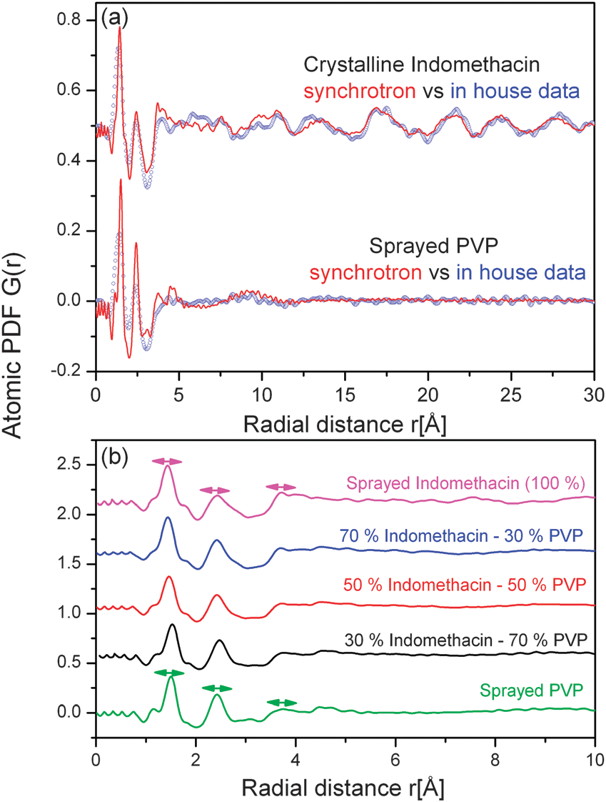
Indomethacin in polymer
V. Petkov, Y. Ren, S. Kabekkodu, D. Murphy, Phys. Chem. Chem. Phys., 2013, 15, 8544

Slide 18
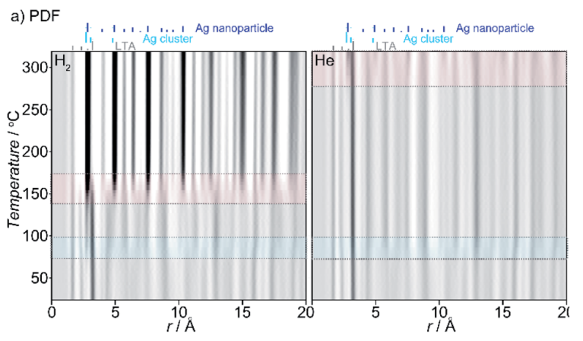
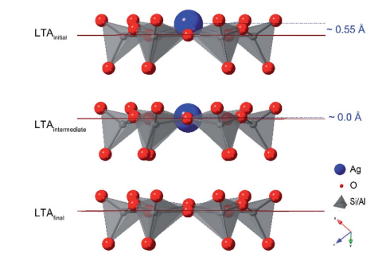
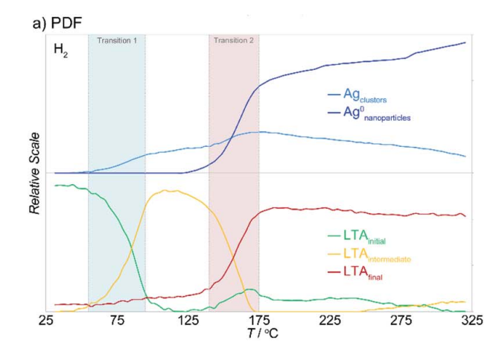
Silver nanoparticles in zeolite
D. O’Nolan, H. Zhao, Z. Chen et al., Chem. Sci., 2021, 12, 13836

Slide 19
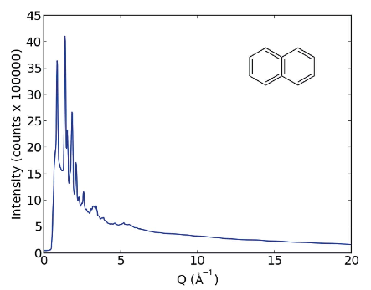
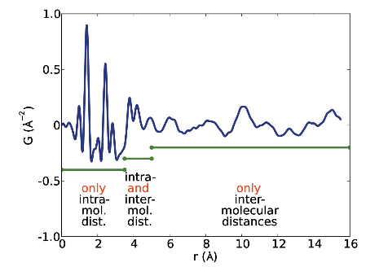
Structure solution from WAXS
Problem: fitting of too many parameters to one structure factor!
D. Prill, P. Juhas, M.U. Schmidt, S.J.K. Billinge, J. Appl. Cryst., 2015, 48, 171

Slide 20
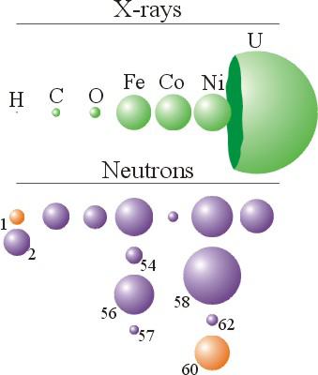
Wide-angle neutron scattering
H/D
D/H
H/H
D/D

Slide 21
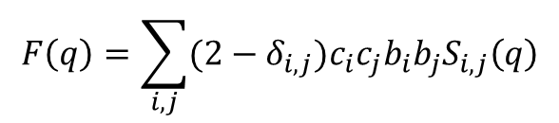
WANS
$$F\left(q\right)=\sum_{i,j}{(2−δ_{i,j})c_{i}c_{j}b_{i}b_{j}S_{i,j}\left(q\right)}$$
Water
i | j | c_{i} | c_{j} | b_{i}, fm | b_{j}, fm | c_{i}c_{j}b_{i}b_{j} = w_{ij}, fm
O | O | 1/3 | 1/3 | 0.5804 | 0.5804 | 0.0374
O | H | 1/3 | 2/3 | 0.5804 | -0.3741 | -0.0482
H | H | 2/3 | 2/3 | -0.3741 | -0.3741 | 0.0622
Heavy water
i | j | c_{i} | c_{j} | b_{i}, fm | b_{j}, fm | c_{i}c_{j}b_{i}b_{j} = w_{ij}, fm
O | O | 1/3 | 1/3 | 0.5804 | 0.5804 | 0.0374
O | D | 1/3 | 2/3 | 0.5804 | 0.6674 | 0.0861
D | D | 2/3 | 2/3 | 0.6674 | 0.6674 | 0.1980

Slide 22
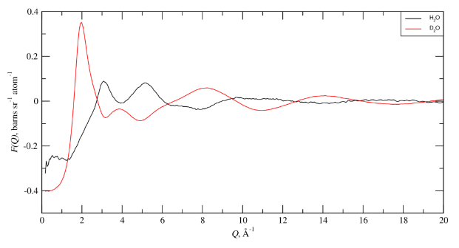
WANS

Slide 23
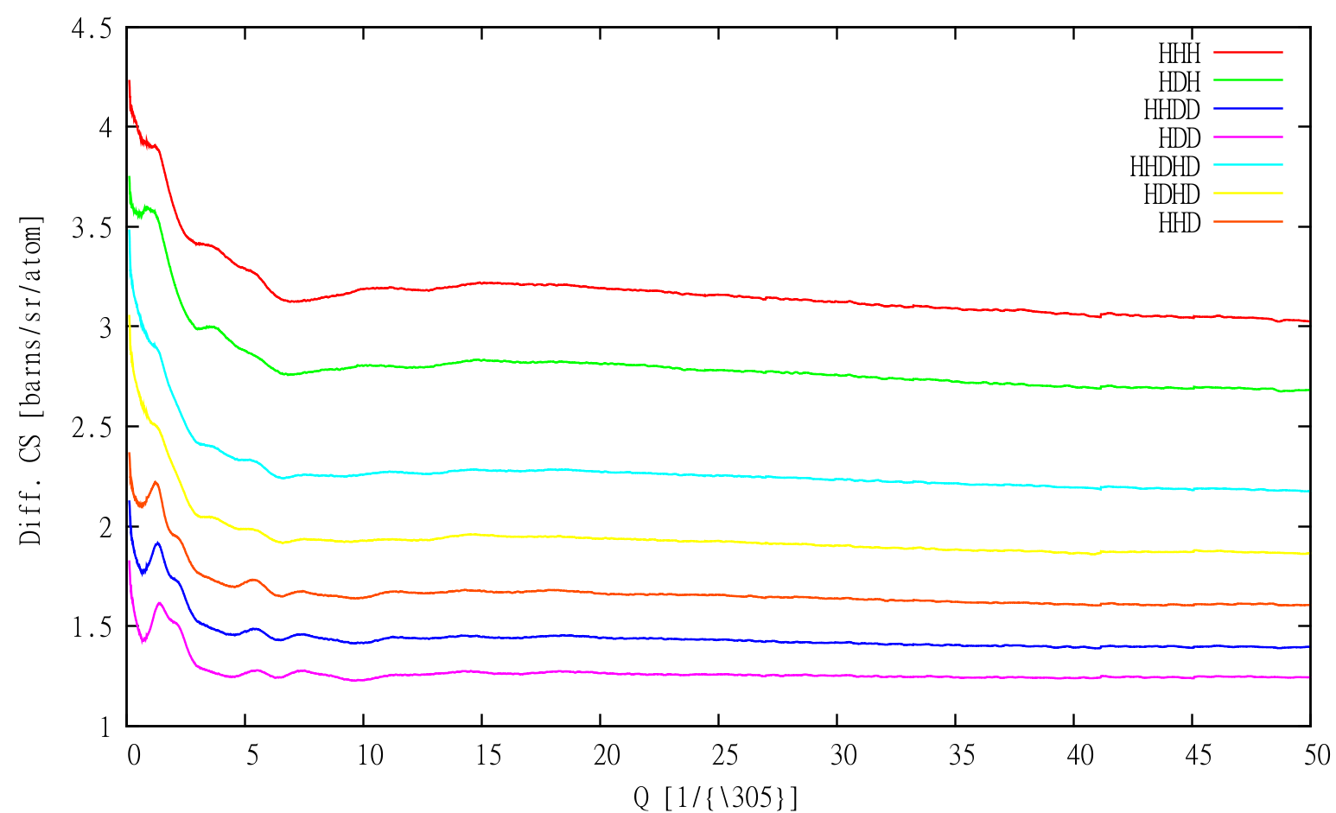
WANS
Each isotopic mixture gives one structure factor
Different correlations can be extracted from each structure factor
https://www.isis.stfc.ac.uk/OtherFiles/Disordered%20Materials/DM%20Isotopic%20Substitution%20Experiments%20v1.0.pdf

Slide 24
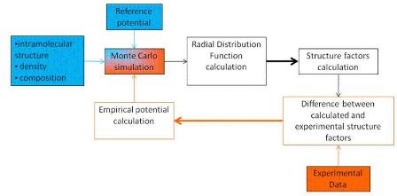
Generation of structural models
EPSR (empirical potential structure refinement)

Slide 25
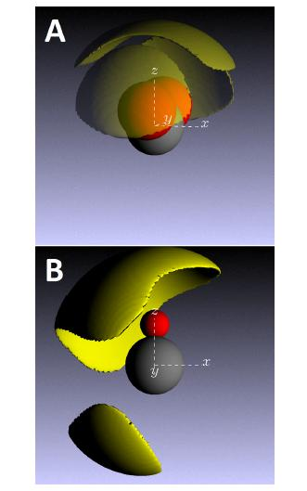
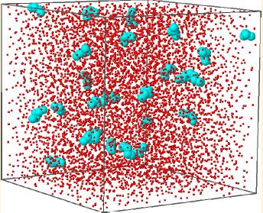
Generation of structural models
N.H. Rhys, A.K. Soper, L. Dougan, J. Phys. Chem. B, 2012, 116, 13308

Slide 26
Applications

Slide 27
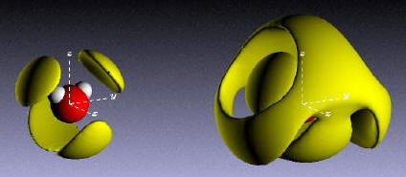
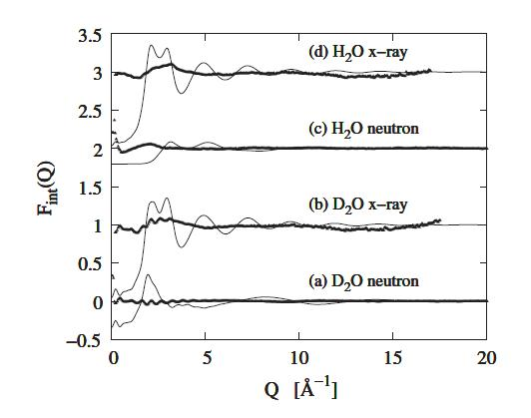
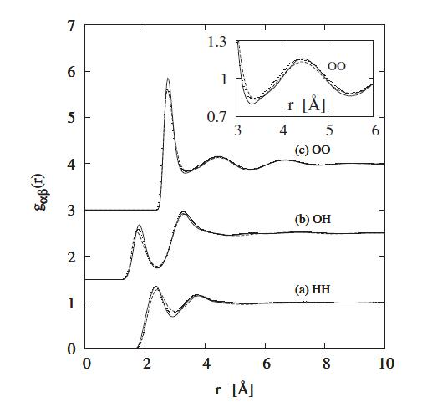
Water
A. Soper, C.J. Benmore, Phys. Rev. Lett., 101, 065502

Slide 28
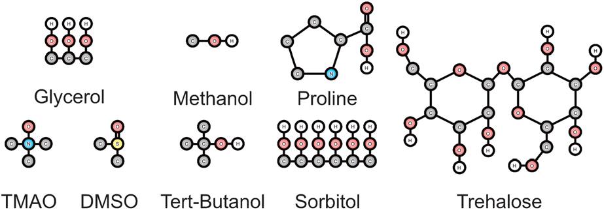


Antifreeze effect
J.J. Towey, A.K. Soper, L. Dougan, Faraday Disc. 2013, DOI 10.1039/c3fd00084b

Slide 29



Small peptides
S. Busch, C.D. Bruce, C. Redfield, C.D. Lorenz, S.E. McLain, Angew. Chem. Int. Ed., 2013, 52, 1

Slide 30



Drug compounds
L. Tavagnacco, J.W. Brady, F. Bruni, S. Callear, M.A. Ricci, M.L. Saboungi, A. Cesaro, J. Phys Chem. B, 2015, 119, 13294

Slide 31





Ionic liquid/ salt melt
Imidazole-imidazole distance
Imidazole-chloride distance
C. Hardacre, J.D. Holbrey, S.E.J. McMath, D.T. Bowron, A.K. Soper, J. Chem. Phys., 2003, 118, 273

Slide 32


Heterogeneous catalysis
T.G.A. Youngs, H. Manyar, D.T. Bowron, L.F. Gladden, C. Hardacre, Chem. Sci., 2013, 4, 3484

Slide 33
Conclusion
Wide angle scattering gives atomic resolution data
Potential samples are
disordered crystalline materials
Nanomaterials
Solutions
Glasses
Using WANS and WAXS in combination with Monte Carlo simulation can give a structural snap-shot of the disordered phase

